Slide 1
Social Network Analysis Focused Research Process
Sean P. Goggins, Ph.D

Slide 2
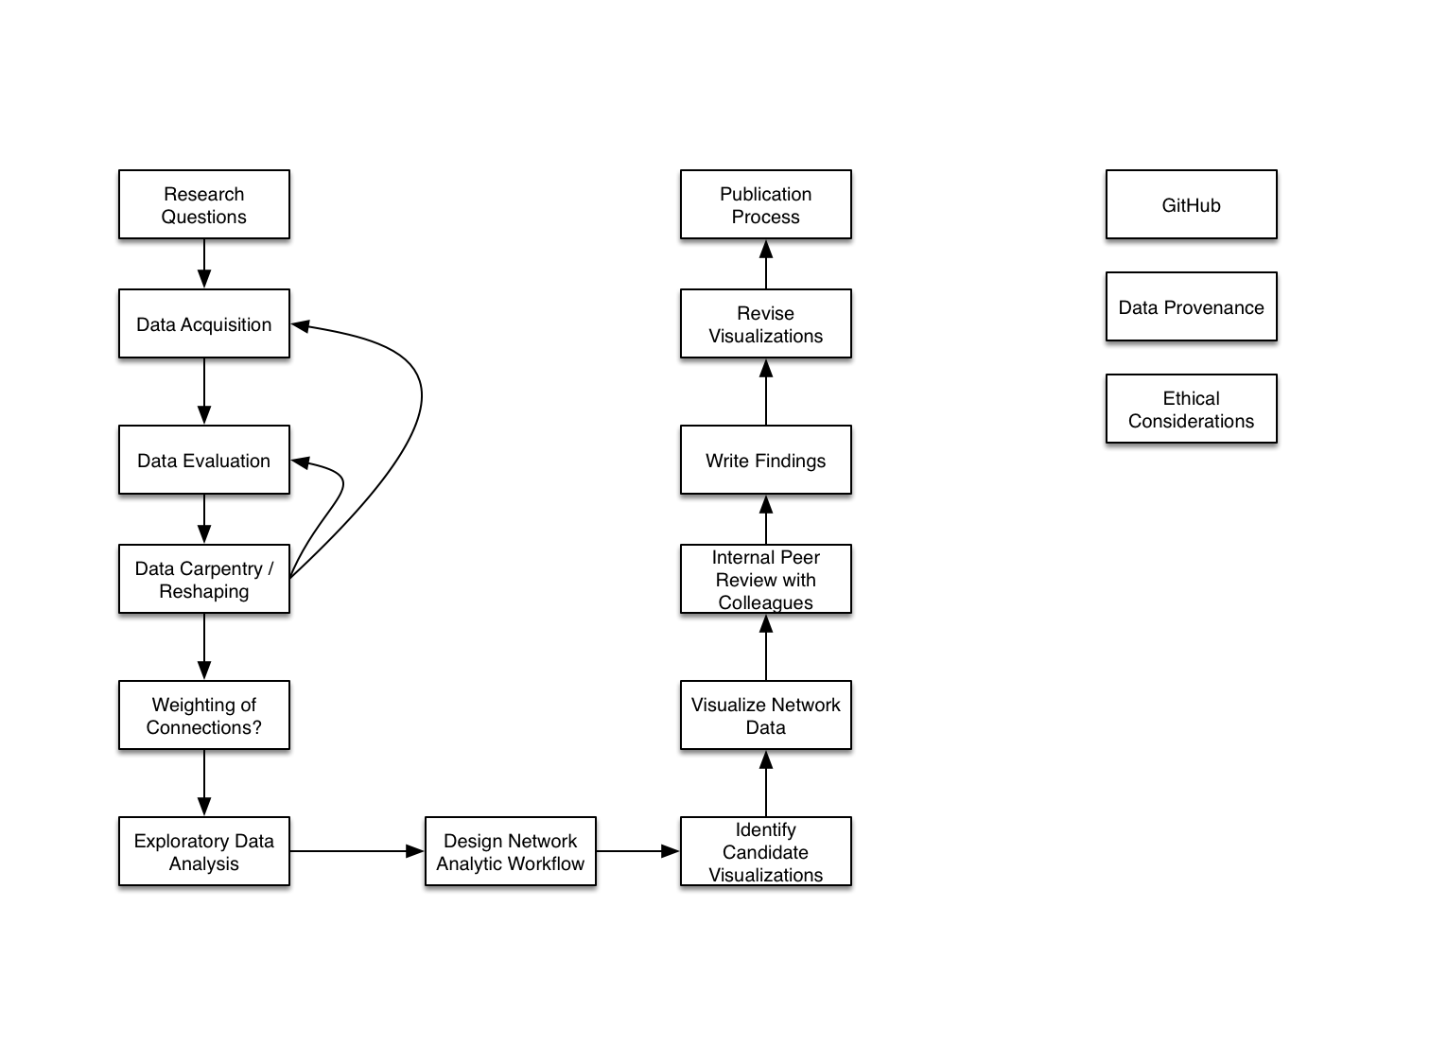
High Level Overview

Slide 3
Data Carpentry/Reshaping

Slide 4
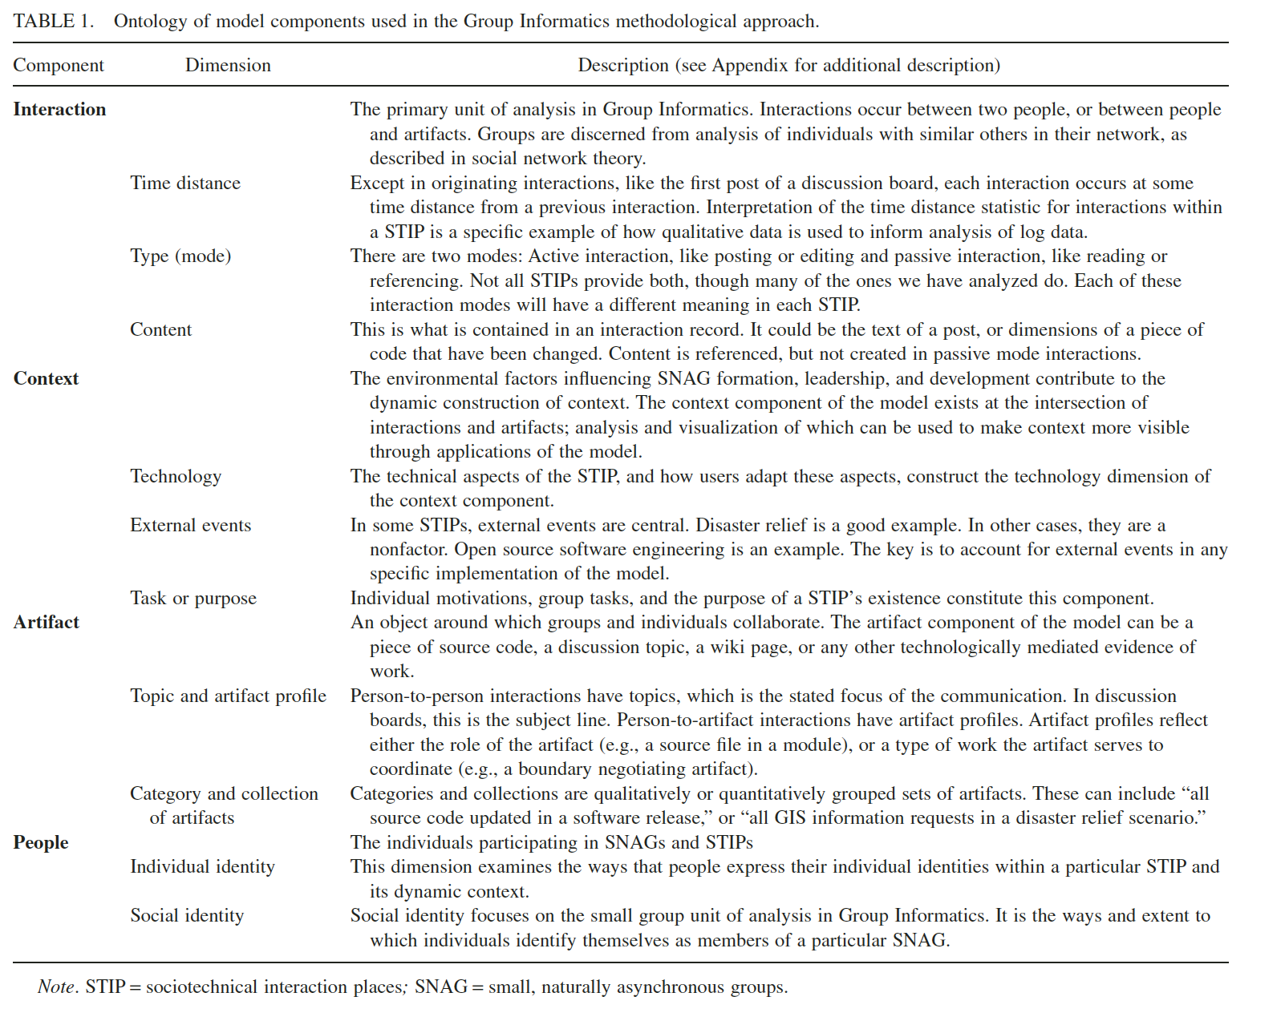
Weighting Questions

Slide 6
Thank You

